Slide 1


Slide 2
English in your studies
An indispensable tool :
1- To validate your diploma
2- To improve your level in technical research
3- To integrate a specific school
4-To find an internship or a job abroad
5- To access the 80% of web content in English

Slide 3
I Goals
I-To be able to communicate in proper English
II- To learn about technical vocabulary
III To broaden your cultural reference
IV To know how to get the information needed in English

Slide 4

II Communication in English
English will be the only means of communication !
I- Oral presentations in class
II Discussions and debates in groups
III Business communication

Slide 5

III Technical English
Based on different supports ( videos TED, articles, websites and your courses in French )
Technical presentation topics

Slide 6
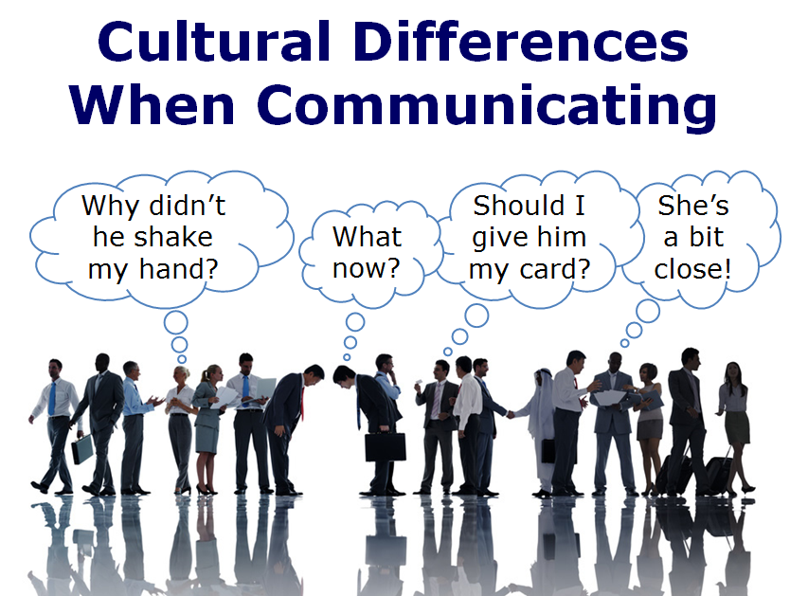
IV Cultural agenda
The English-speaking world and the world of work
Intercultural differences

Slide 7

V Skills
5 different skills to practice :
Oral comprehension
Written comprehesion
Oral expression ( alone and with pairs)
Written expression

Slide 8


VI Tests
- Written tests in class and exams
- Oral tests in class

Slide 9
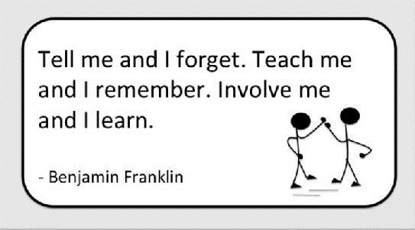
To conclude
Improvement as an objective
Involvement as means
Be an actor of your training
It is never too late to improve

Slide 10
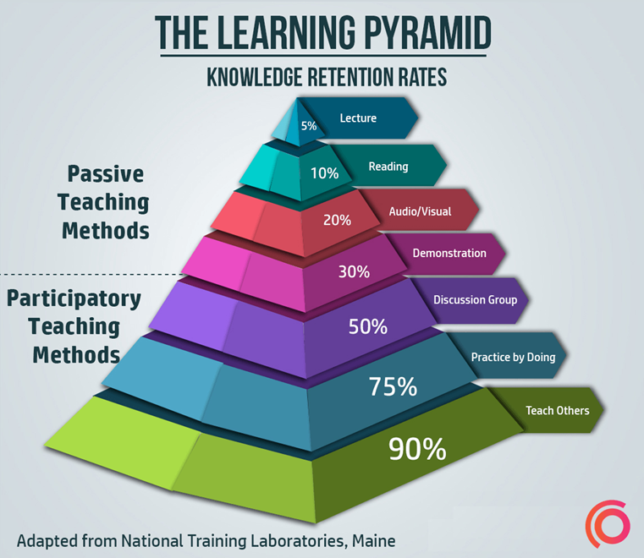

Slide 11
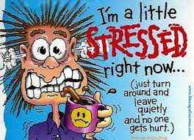
Would you rather …..............?
1. Would you rather be able to fly or read minds?
2. Would you prefer to get rich in a way that disappoints your family or just make enough money to live?
3. Would you rather have hiccups for a whole day or feel like you have to sneeze but can’t for a whole day?
4. Would you rather have no internet or no cell phone?
5. Would you prefer to go back in time to meet your ancestors or go into the future to meet your great-grandchildren?
6. Would you rather find true love or $10 000 000?
7. Would you rather be able to talk with all animals or be able to speak all foreign languages?
8. Would you prefer to have more time or have more money?

Slide 12
English Tense Exercise
1. A: You seem energetic! B: Really, I (exercise) for some time.
2. A: What (you, do) when the robbery took place? B: I (change) a light bulb that had burnt out. 3. Mike (use) the same PC for more than three years. He is thinking of upgrading it. 4. If it (snow) tomorrow, we (go) skiing near Vesuvis. 5. This is the second pill I (take) to make me sleep.

Slide 13
6. Mary (not, call) me since she (leave) the city. 7. By the time the police (arrive) , the robbers (run) away. 8. Hey.. Be quiet! The boss (come) .

Slide 14
9. We are fed up with storm and those dark clouds! We expect, when we (wake) up tomorrow morning, the sun (shine) . 10. When Hasan arrived at the cafe, I (wait) for him for half an hour. 11. I (not, hear) of the pyramids before I went to Egypt. 12. During the past 50 years, traveling (become) much easier and very comfortable. In the 19th century, it (take) two or three months to cross Africa by wagon. The trip (be) very rough and often dangerous. Things (change) a great deal in the last hundred and fifty years.

Slide 15
13. Your English (improve) . You (watch) television programs and (study) grammar every day since you first arrived in London. It is apparent that you will be fluent very soon. 14. When Ted (arrive) home last night, he discovered that Hilary (prepare) a beautiful candle-lit dinner. 15. Do not forget that if you (need) to contact me sometime next week, I (stay) at the Hilton in Istanbul.

Slide 16
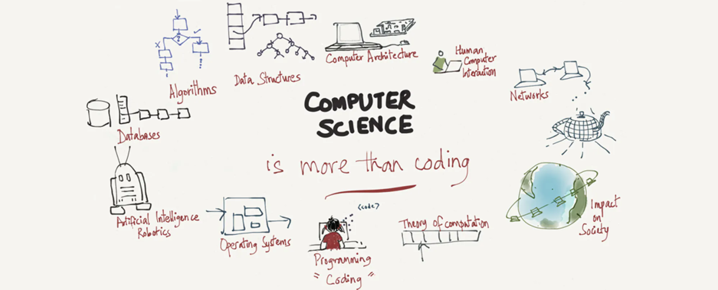
https://www.youtube.com/watch?v=-xFJM3QQ3TE
What is Computer Science ?

